Slide 1
Working with GitHub
EMC coderDojo 2014

Slide 2
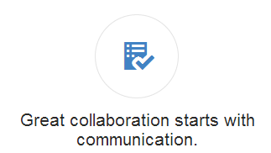
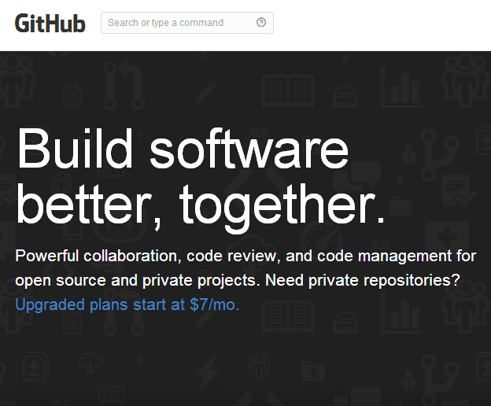
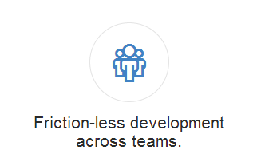

Introduction
www.github.com
GitHub is a web-based hosting service for software development projects.
It makes use of the Git revision control system.
EMC coderDojo members can use this system to Store, Share and Control Project work.

Slide 3

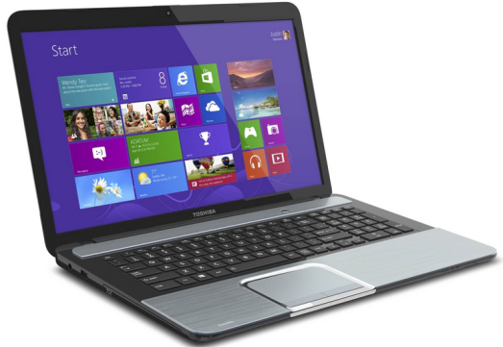
Git and GitHub
What’s involved.
We will be using two items – Git and GitHub
You will Install Git on your computer
And you will make use of the emcdojo account on the GitHub web site
Project work held on the GitHub web site is available to be shared with other EMC coderDojo members

Slide 4
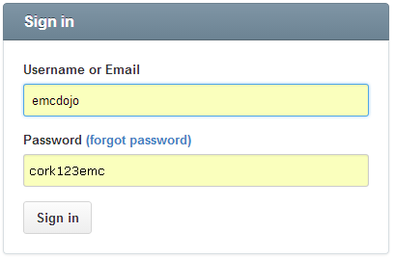
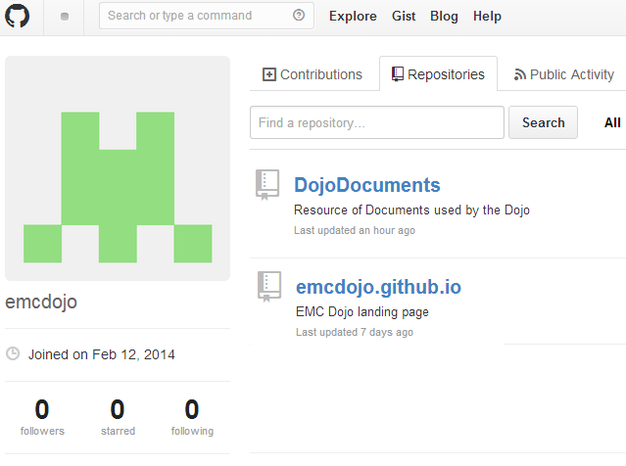
Look at GitHub.com on the web
Account Details
Username – emcdojo
Email – emcdojo@gmail.com
Password – cork123emc
Once you logon you will find a list of the projects that have been created by EMC coderDojo members.

Slide 5
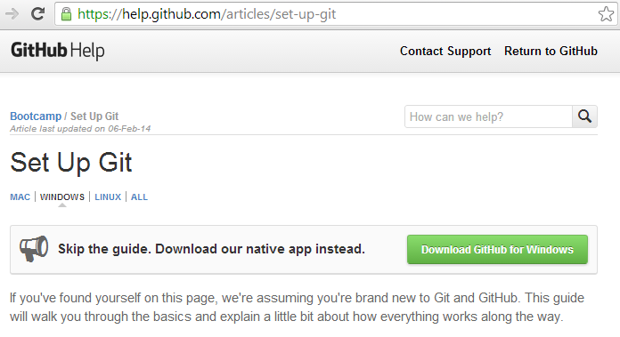

Setup Git on your computer
Download GitHubSetup.exe
Find “Download GitHub for Windows” on the GitHub help screen to start the download of the GitHubSetup.exe file to your ^{computer}

Slide 6
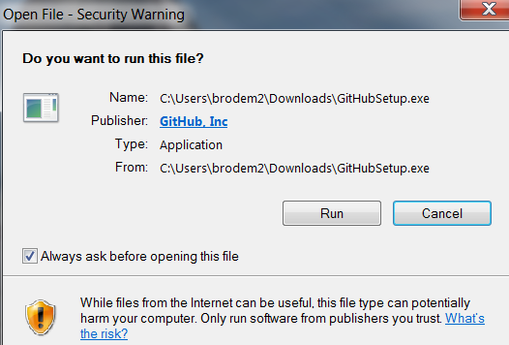
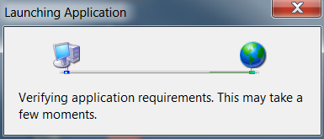
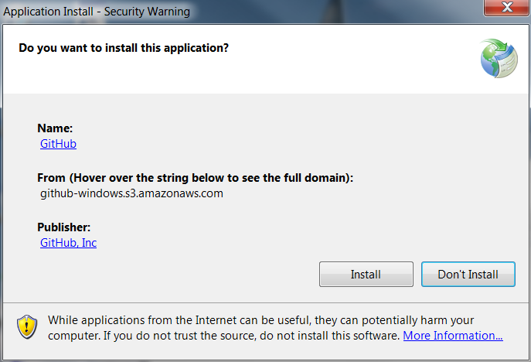
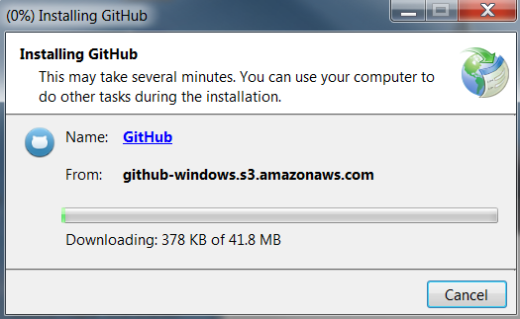
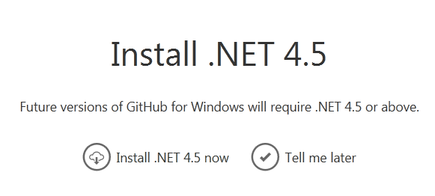

Install
Steps
Run the GitHub.exe file
And click on the Install option button
You may need to install .NET 4.5 also
This will be loaded if required automatically

Slide 7
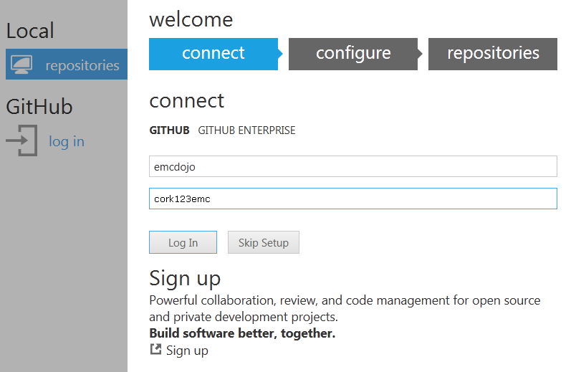
First Step - Link to GitHub Web
Start GitHub on your computer
Connect to the
emcdojo account
Use the account name and password show

Slide 8
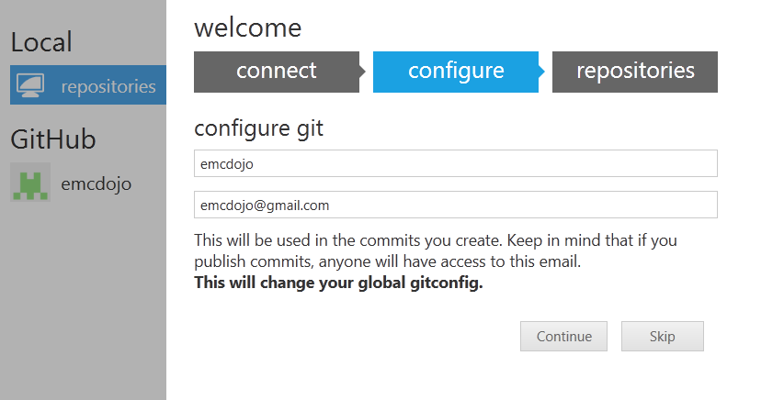
Link to GitHub Web
Configure
Enter the configuration information as shown

Slide 9
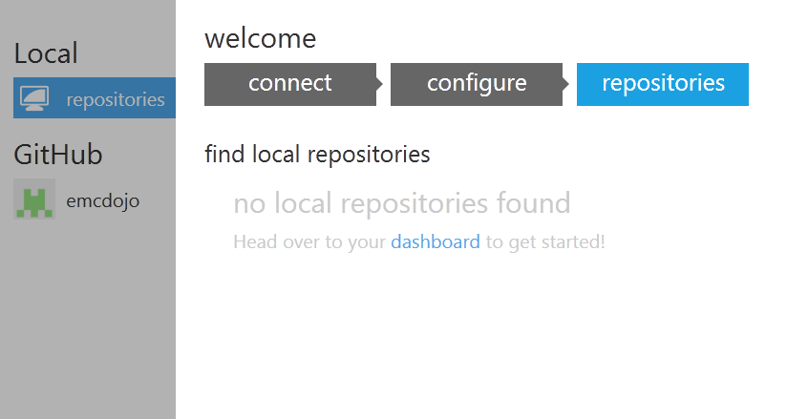
Link to GitHub Web
Repositories
Repositories are a special storage location that hold all the files and folders related to a project. They are a good place to group all your information in one place for a given project.
Local repositories are on your computer. These are for your working files.
GitHub repositories are on the web. And the master copy of your files are kept there.

Slide 10
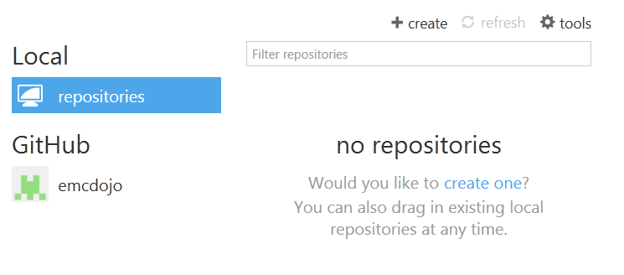
Local
Your working area
When you first install GitHub on your computer, the local repositories area will be empty
In this area you can create new repositories for your new projects. This is the area where you will do work on the files of your project.

Slide 11
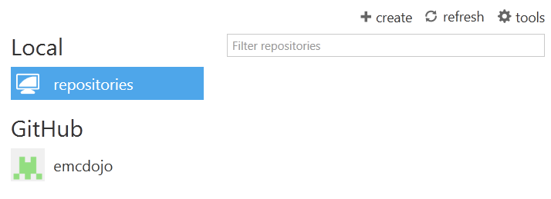
Make your first Repository
Create
When you first install GitHub on your computer, the local repositories area will be empty
In this area you can create new repositories for your new projects.
The repository is the area where you will keep the files for your project.

Slide 12
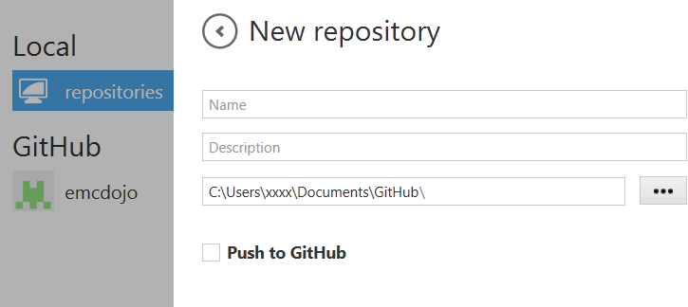

Name and Create the Repository
Steps
Enter a Name for your repository
Enter a Description for what your project is about and what the repository will be used for
The location for the repository on your computer will auto-fill
The Push to GitHub tick box is only selected if you want to have this repository on the web (where other EMC coderDojo users can see it)
In this test example we will not Push to GitHub
Click Create to finish

Slide 13
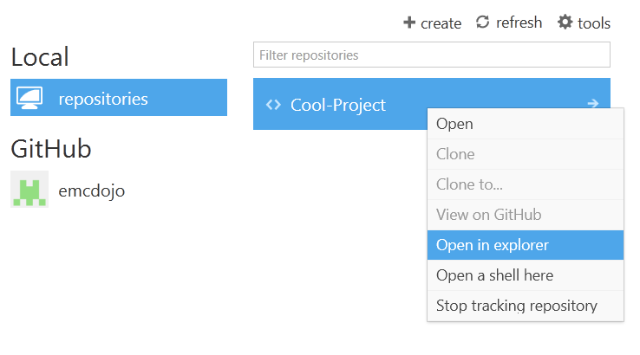
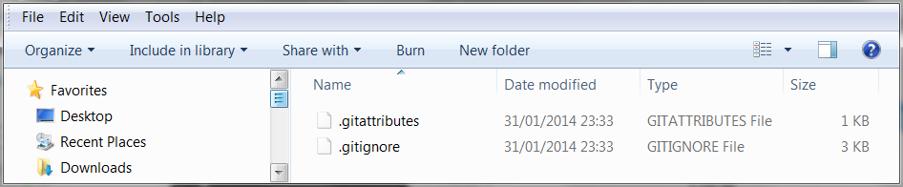
View your first Repository
Steps
Right click on the repository you just created and select the Open in explorer option
This will open a window and you will see the folder where your project files will be kept.
Some GitHub system files will already be in place there.

Slide 14
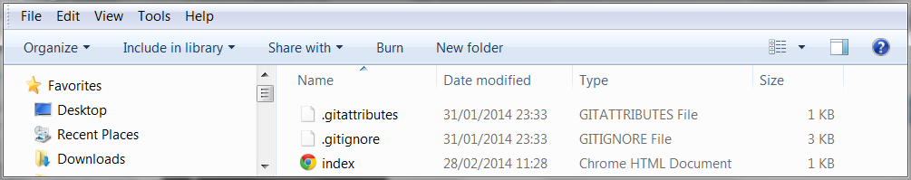
Add a file to your Repository
Steps
Create a file and save it to the location of your repository on your computer
In this example we have added a file called index.html which we created using Notepad.

Slide 15
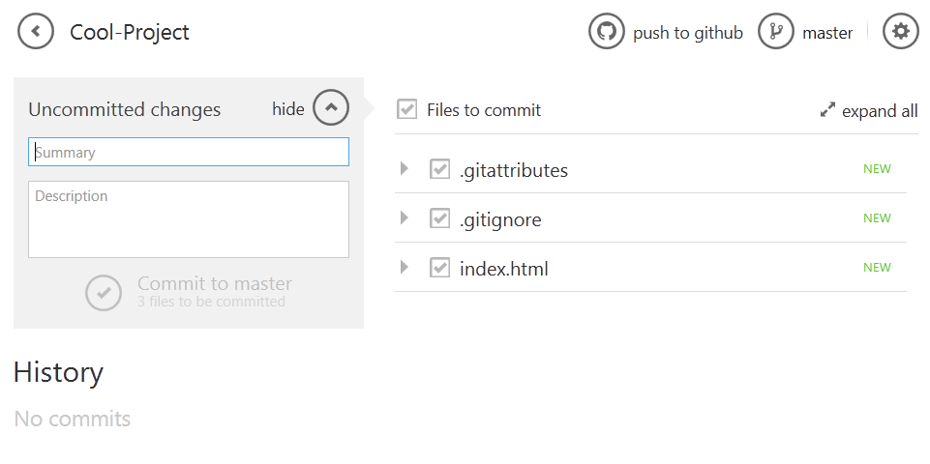
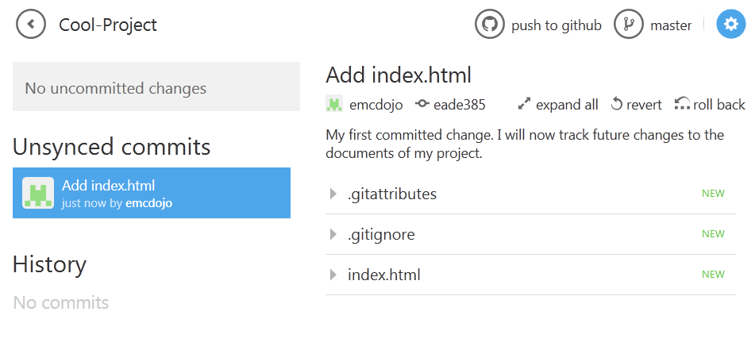
Track changes in your Repository
Commit to Master
Enter Summary and Description information as a future reminder of the changes you have made.
Click on the Commit to master button to record your change
GitHub has now recorded your current position in your project and you have a snap shot of your files for future reference.
This is important if you need to come back to this version of the files at some point in the future

Slide 16
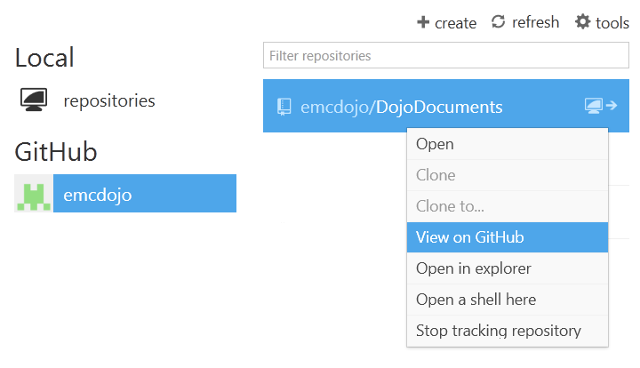
Viewing a Master Repositories
Select
Right click on the GitHub repository and use the View on GitHub option
This will open your browser and bring you to the top level of the repository you have selected – listing the files and folders contained there.

Slide 17
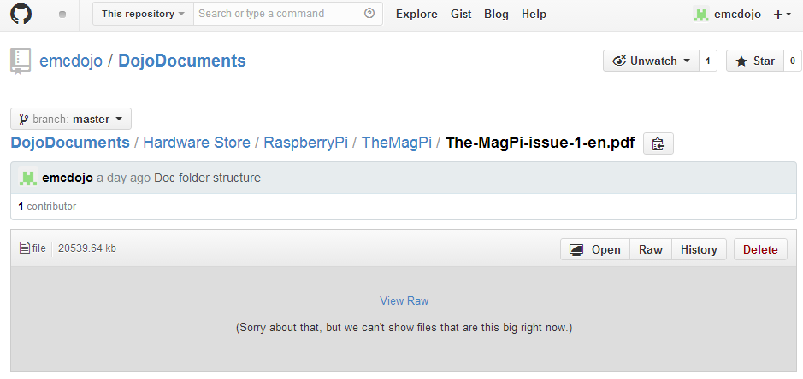
Open file on Master Repositories
How to view a file from the web repository
Navigate to the file you want to view and select
In some cases you will need to use the View Raw option to see the file.

Slide 18
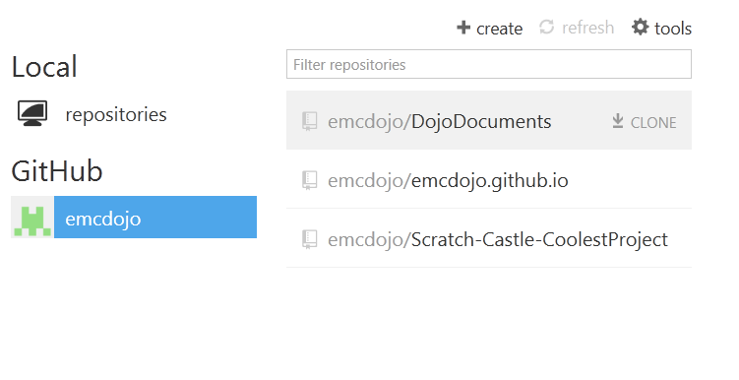
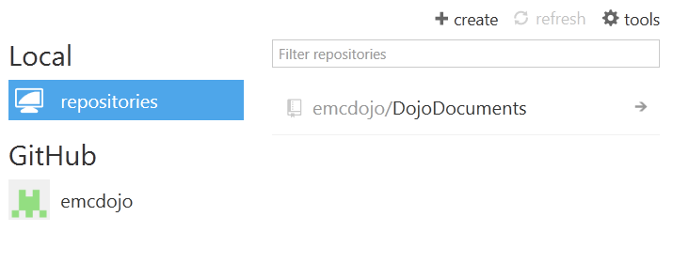
Working with Master Repositories
Clone function
The GitHub list will show the names of all the web repositories available. Some repositories have already been created by other EMC coderDojo members.
The Clone option is used to bring a copy of any repository into your local machine – if you want to change the content or work on another persons project.
Once you have a copy on your local area you can then start to view the files on your computer.

Slide 19
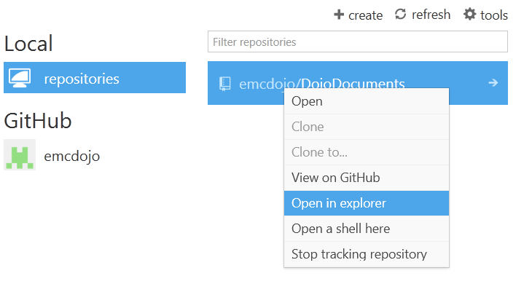
Working with a Clone copy
Open in explorer
Right click on the repository you want to work with and select the Open in explorer option.
If you need to record changes back to the Master repository (so that others can make use of your work), then you will need to commit your changes and sync them back to the Master.

